Slide 1
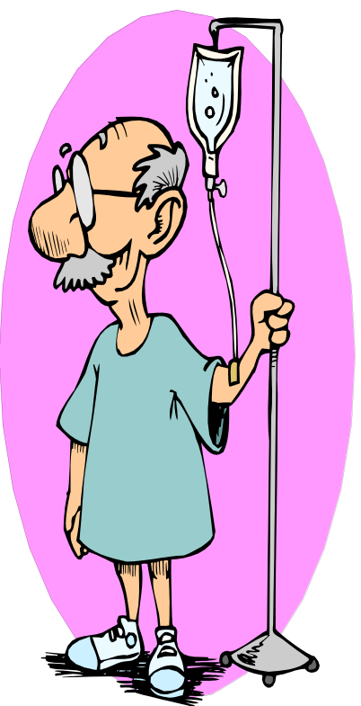
Electrolyte Disorders
Neela Bhajandas, PharmD.
Clinical Assistant Professor of Pharmacy
Neela.Bhajandas@temple.edu
Spring 2014

Slide 2
Potassium Homeostasis
Hormones:
Insulin
Glucagon
Catecholamines
Aldosterone
Na+
2 K+
K+
3 Na+
K+
Intracellular K+= 150 mEq/ L
Extracellular K+ = 3.5- 5.0 mEq/L
Notes:
00:00

Slide 3
Potassium Homeostasis
K+ is the major intracellular cation
Normal serum K+= 3.5- 5.0 mEq/L
~70% of intracellular K+ is located in the skeletal muscle and the remainder is in the liver and red blood cells
Kidney is the primary route of elimination of potassium
Physiologic functions:
  Glycogen synthesis
  Cellular metabolism and growth
  Action potential across cell membrane
  Effects neuromuscular activity (cardiac conduction)
Notes:
2:12

Slide 4
Hypokalemia (< 3.5 mEq/L)

Slide 5
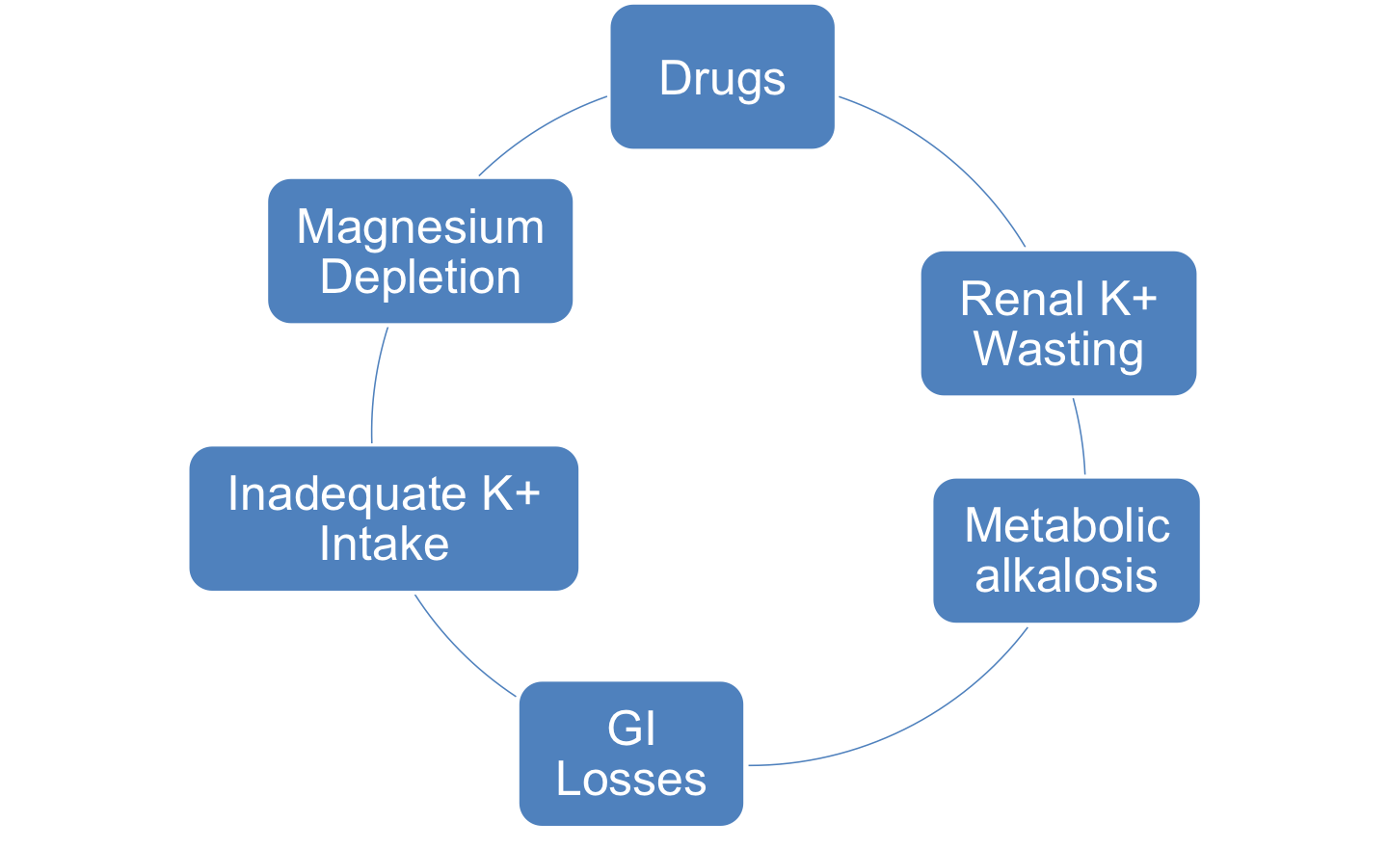
Causes of Hypokalemia
Magnesium enhances the function of Na-K-ATPase pump and prevents renal loss of potassium
Urinary losses can occur with mineralocorticoid excess (aldosterone) and diuretic use (loop and thiazide diuretics)
Not enough [H+] in the ECF therefore body exchanges K+ for [H+]. K+ moves into ICF and [H+] then moves into the ECF
Vomiting, Diarrhea
Notes:
3:00
Etiology
Drug therapy
Renal K+ wasting
Metabolic alkalosis
GI losses (diarrhea/ vomiting)
Inadequate intake of K+
Fruits, vegetables, meats
Magnesium depletion
↓ Intracellular K+ concentrations
Promotes renal K+ wasting (↓ magnesium impairs the Na-K-ATPase pump which ↑ K+ wasting)

Slide 6
Drug-Induced Causes of Hypokalemia
Intracellular shift K+ ( ECF ICF) | Enhanced renal excretion | Enhanced fecal elimination
Insulin | Thiazide diuretics | Sodium polystyrene sulfonate (SPS) Cation exchange resin, exchanges Na for K+ in the intestine
β- agonists | Loop diuretics | Sorbitol
*Albuterol | High dose penicillin
Theophylline | Cisplatin
Epinephrine | Acetazolamide
Ephedrine | Amphotericin B
Pseudoephedrine | Aminoglycosides
 | Conivaptan
Notes:
6:30

Slide 7
Clinical Manifestations of Hypokalemia
 | Potassium level | Adverse Effects | Treatment
Mild- Moderate Hypokalemia | K+(2.5- 3.5 mEq/L) | Nausea/ vomiting, fatigue, weakness, myalgia, cramps | Oral (PO) therapy preferred over IV
Severe Hypokalemia | K+ < 2.5 mEq/L or SYMPTOMATIC hypokalemia | Cardiac arrhythmias, respiratory dysfunction, muscle necrosis, paralysis | Must use IV therapy in severe hypokalemia, symptomatic hypokalemia, lack of enteral route (NPO)
Notes:
1022

Slide 8
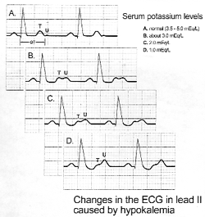
Hypokalemia EKG changes
K+ = 3.5- 5.0 mEq/L
K+ = 3.0 mEq/L
  T wave starting to go ↓
  U wave ↑
K+ = 2.0 mEq/L
K+ = 1.0 mEq/L
  T wave almost non-existent
  Severe U-wave elevation
Most serious complication associated with hypokalemia is cardiac arrhythmias and sudden death
Notes:
11:30
FYI

Slide 9
Treatment of Hypokalemia
Correct any underlying acid-base disorder
Encourage increase in dietary K+
  i.e. Dried figs, dried fruits, nuts, spinach, bananas, etc.
Oral therapy preferred in asymptomatic patients with a K+ ≥ 2.5 mEq/L
Potassium level | Treatment (pharmacotherapy)
3.0- 3.5 mEq/L | Treat in patients with underlying cardiac disorders
x < 3.0 mEq/L | Treat ALL patients (potassium goal of 4.0 mEq/L)
Notes:
13:30

Slide 10
Treatment of Hypokalemia
Example of dosage of K+ replacement for patients with normal renal function
K+ (mEq/L) | KCL dosage (mEq)
3.5- 3.9 | 40 mEq x 1
3.0- 3.4 | 40 mEq x 2
2.0- 2.9 | 40 mEq x 3+
Check K+ levels 1-4 hours after repletion
Dickerson. Hospital Pharmacy 2001; 36: 1201d
Notes:
Decrease dose in renal function by 50%

Slide 11
Potassium salt products
Salt | Dosage form | Brand name / other
Potassium chloride *most common formulation | IV, elixir, controlled-release, microencapsulated, wax matrix, powder | K-dur, Klor-con, Micro-K, etc.
Potassium phosphate (Kphos) | 4.4mEq Potassium/3 mmol Phosphate/ mL (IV) | Used in patients with hypophosphatemia
Potassium acetate | 2mEq/ml (IV) | Used in patient with acidosis
Potassium bicarbonate | 25 mEq Effervescent tablet (PO) | K-lyte, K-Vescent Use in patients with acidosis
Potassium citrate | 5 or 10 mEq capsule & extended release (PO) | Urocit-K Use in patients with acidosis
Potassium gluconate | 20mEq/15ml elixir, 2-5 mEq tablet (PO) | Use in patients with acidosis
Notes:
20:40

Slide 12
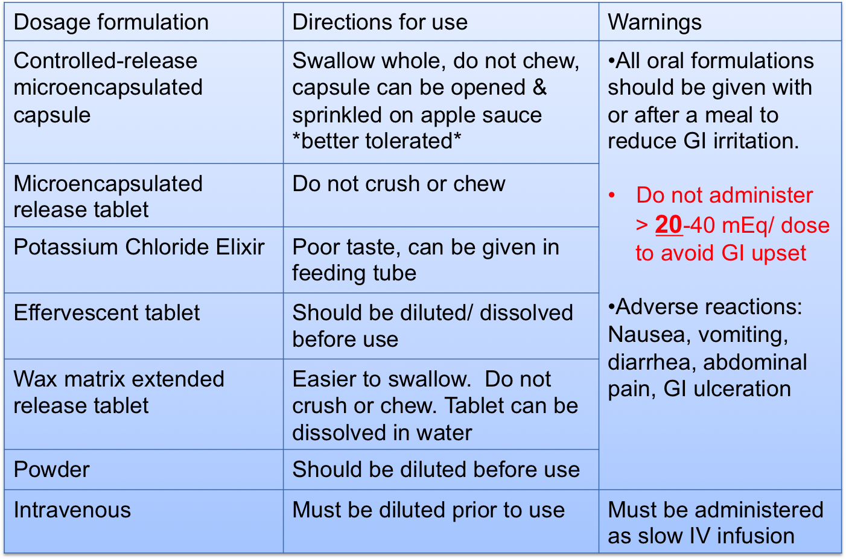
Common Potassium Dosage Forms

Slide 13
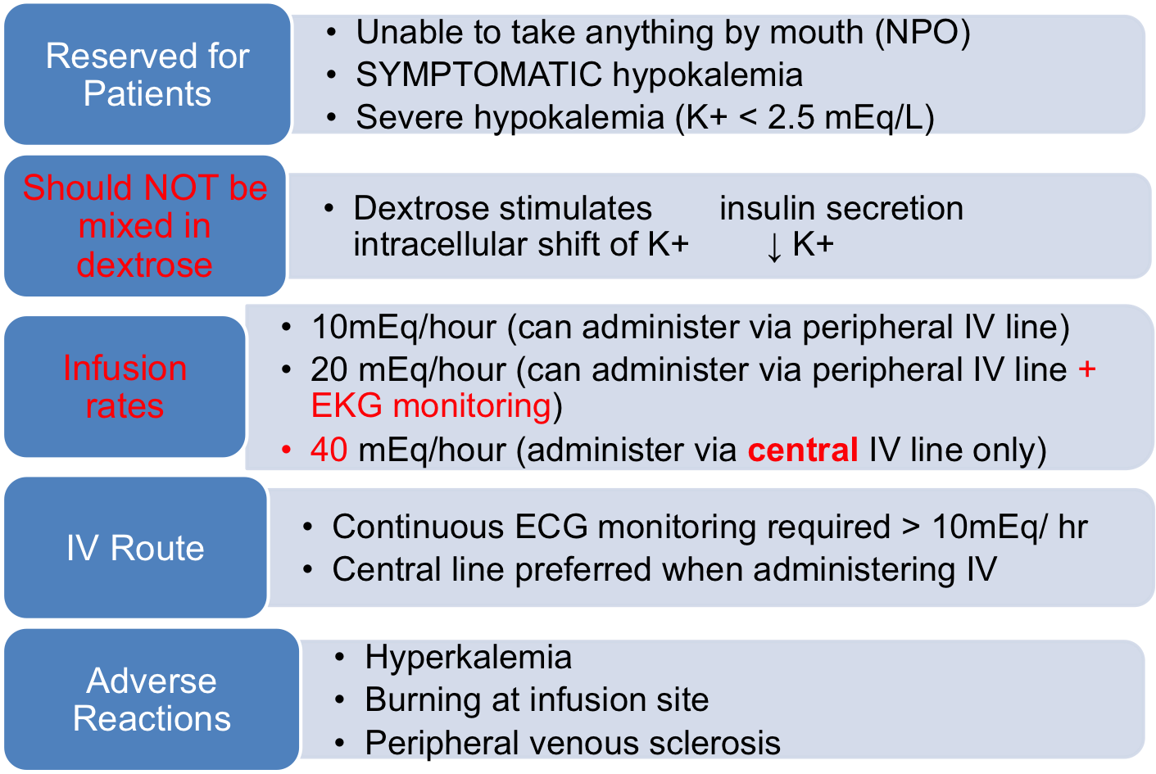
Intravenous (IV) Potassium

Slide 14
Treatment Algorithm for Hypokalemia
Treat all patients
⬇
K+ < 3.0 mEq/L
(PO or IV)
K+ < 2.5 mEq/L(IV)
Hypokalemia
K+ 3.5- 3.9 mEq/L
K+ 3.0- 3.5 mEq/L
EKG Monitoring present
EKG Monitoring NOT present
To consider supplementation for patients with an underlying cardiac disorder
Oral or IV supplementation for patients with an underlying cardiac disorder
Oral therapy is preferred- use IV therapy ONLY when:
Severe hypokalemia (K < 2.5 mEq/L)
SYMPTOMATIC hypokalemia
Lack of enteral route (NPO)
IV Infusion rate NOT to exceed
40 mEq/hour
IV Infusion rate NOT to exceed
10 mEq/hour

Slide 15
Monitoring
Check potassium levels 1- 4 hours after administration in hospitalized patients
Check magnesium levels
  Hypomagnesemia (Mg < 1.7 mg/dl)
  To prevent refractory hypokalemia
Concomitant EKG monitoring
  IV potassium administration (x > 10 mEq/ hour)
Renal function
  Dose cautiously in patients with renal failure
  Decrease dose by 50%

Slide 16

Case #1
Notes:
IV
Goal: 3.5 mEq/L
3.5 – 2.4 = 1.1 serum
10 mEq dose = 0.1 serum
10 dose / 0.1 * 1.1 = 110 mEq dose
40 mEq dose x 3
Renal = 20 mEq x 3

Slide 17
Case #2
AR is a 65 y/o male who was admitted to TUH 4 days ago with a HF exacerbation. His current medications include: ASA 81 mg po daily, lisinopril 40 mg po daily, metoprolol XL 100 mg po daily, digoxin 0.125 mg po daily, furosemide 80 mg IV q12 hours, and an insulin drip 100 units/ 100 mL NS 3 units/hour.
Pertinent labs include:
Na= 136 mEq/L, K= 3.1 mEq/L , Bun= 24, Scr= 1.1
What is the most likely cause of AR’s hypokalemia?
Develop a treatment plan for his hypokalemia (dose, route, and dosage formulation) if you think he needs to be treated.
Notes:
Low K
Fusosemide and insulin
3.5 – 3.1 = 0.4 mEq serum
10 dose / 0.1 serum * 0.4 = 40 mEq/dose
KCl 20 mEq PO BID

Slide 18
Example of Replacement Protocol
Potassium IV Replacement Protocol Example (for non-emergent situations in patients with no renal insufficiency)
Normal: | More Aggressive:
Labs: Recheck serum K+ 1hour after IV bolus* Serum K+ level every ______ hours Serum magnesium with next blood draw Serum glucose with next blood draw Basic metabolic panel with next blood draw Arterial Blood gas now
Serum K+ Level (mEq/L) | K+ Dose
3.6 or greater | None
3.3- 3.5 | 20 mEq KCL
3.0- 3.2 | 40 mEq KCL
x < 3.0 | 40 mEq KCL and call physician
Serum K+ Level (mEq/L) | K+ Dose
4.0 or greater | None
3.5- 3.9 | 20 mEq KCL
3.3- 3.4 | 40 mEq KCL
3.0- 3.2 | 40 mEq KCL x 2
x < 3.0 | 40 mEq KCL x 2 and call physician
Notes:
00:00

Slide 19
Magnesium Homeostasis
Notes:
↑, ↓, or ↔

Slide 20
Magnesium Homeostasis
Normal range: 1.7- 2.3 mg/dL
Primarily found in bone, muscle, and soft tissue
30- 40% absorbed in the small bowel
Kidneys play a major role in the balance
  Reabsorbed in the proximal tubule and Loop of Henle
Acts as a cofactor in many enzyme systems (ATP production) and neuromuscular function
  Nerve conduction, cell membrane function, PTH secretion
Effects potassium and calcium homeostasis
  Plays a significant role in renal absorption of K+
Notes:
00:45

Slide 21
Hypomagnesemia (< 1.7 mg/dL)
Normal 1.7–2.4 mg/dL

Slide 22
Causes of Hypomagnesemia
Disorders of the GI tract | Kidney | Drugs
Small bowel disease | Increased renal excretion | Aminoglycosides
Malnutrition | Nephrotic syndrome | Amphotericin B
Alcoholism | Renal magnesium wasting | Cyclosporine Tacrolimus
Malabsorption |  | Diuretics
Diarrhea |  | Digoxin
 |  | Cisplatin

Slide 23
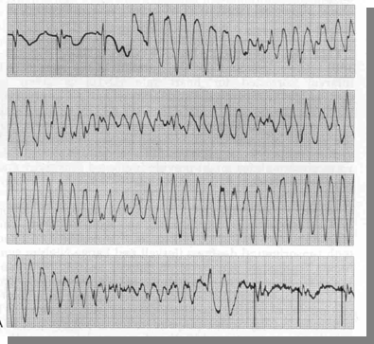
Clinical Manifestations of Hypomagnesemia
Neuromuscular
  Lethargy, confusion, facial twitch, tremors, ataxia, seizures
  + Chvostek’s sign, + Trousseau’s sign
Cardiac
  Atrial and ventricular arrhythmias
  QRS widening, peaked to flat T-waves **Torsades de Pointes
Hypokalemia
  Due to a reduction in
  Na+/K/ATPase activity
Hypocalcemia
  Due to a ↓ in PTH secretion and
  Vitamin D deficiency
Notes:
3:15

Slide 24
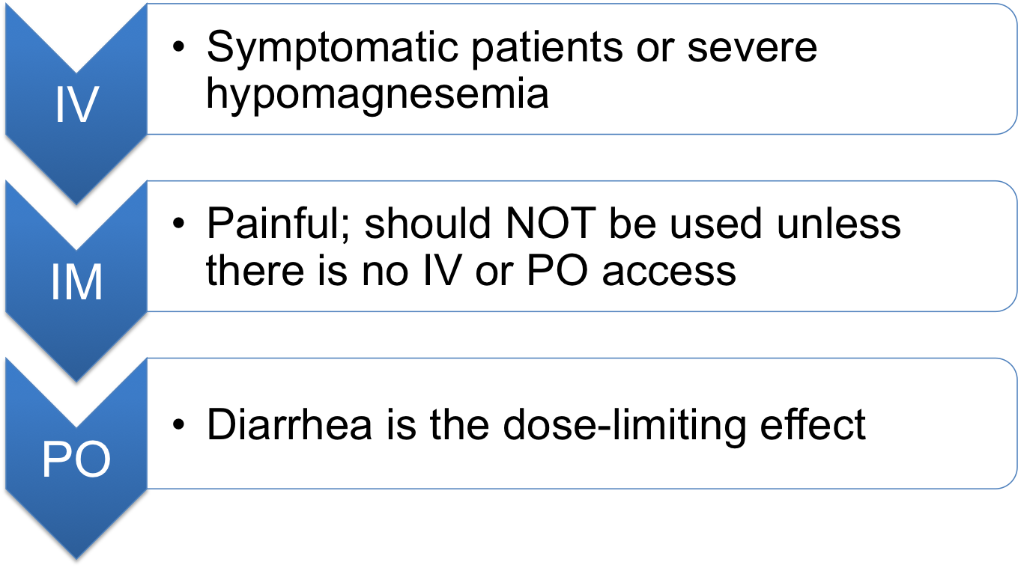
Routes of Administration
Routes of administration depend on the severity of the magnesium depletion and the presence of signs and symptoms
Notes:
4:20

Slide 25
Hypomagnesemia Treatment
Asymptomatic: PO (x ≥ 1.2 mg/dL)
Product | Elemental Magnesium Content
Magnesium oxide | 242 mg in a 400 mg tablet
Magnesium hydroxide | 167 mg in a 400 mg tablet or 5 ml suspension
Magnesium citrate | 48 mg in the 290 mg/ 5 ml solution
Magnesium gluconate | 27 mg in a 500 mg tablet
Magnesium lactate | 84 mg in a 84 mg tablet
Notes:
5:30

Slide 26
Hypomagnesemia Treatment
Normal 1.7–2.4 mg/dL
Severe (< 1.2 mg/ dL): IV therapy should be given with symptomatic or severe hypomagnesemia
  Magnesium sulfate 1 gram = 8 mEq magnesium
    Magnesium sulfate injection: 50% solution available in 2 mL and 10 mL vials (4 mEq/ mL)
    Dilute to a max: 20 gm/ 100 mL (1.6 mEq/ mL)
  Usual infusion rate: 1 gram/ hour
    To avoid hypotension and/or to avoid ↑ renal excretion due to rapid administration
  IV Bolus dose should be avoided
    Flushing, sweating, and warmth
Notes:
6:30
Normal 1.7–2.4 mg/dL

Slide 27
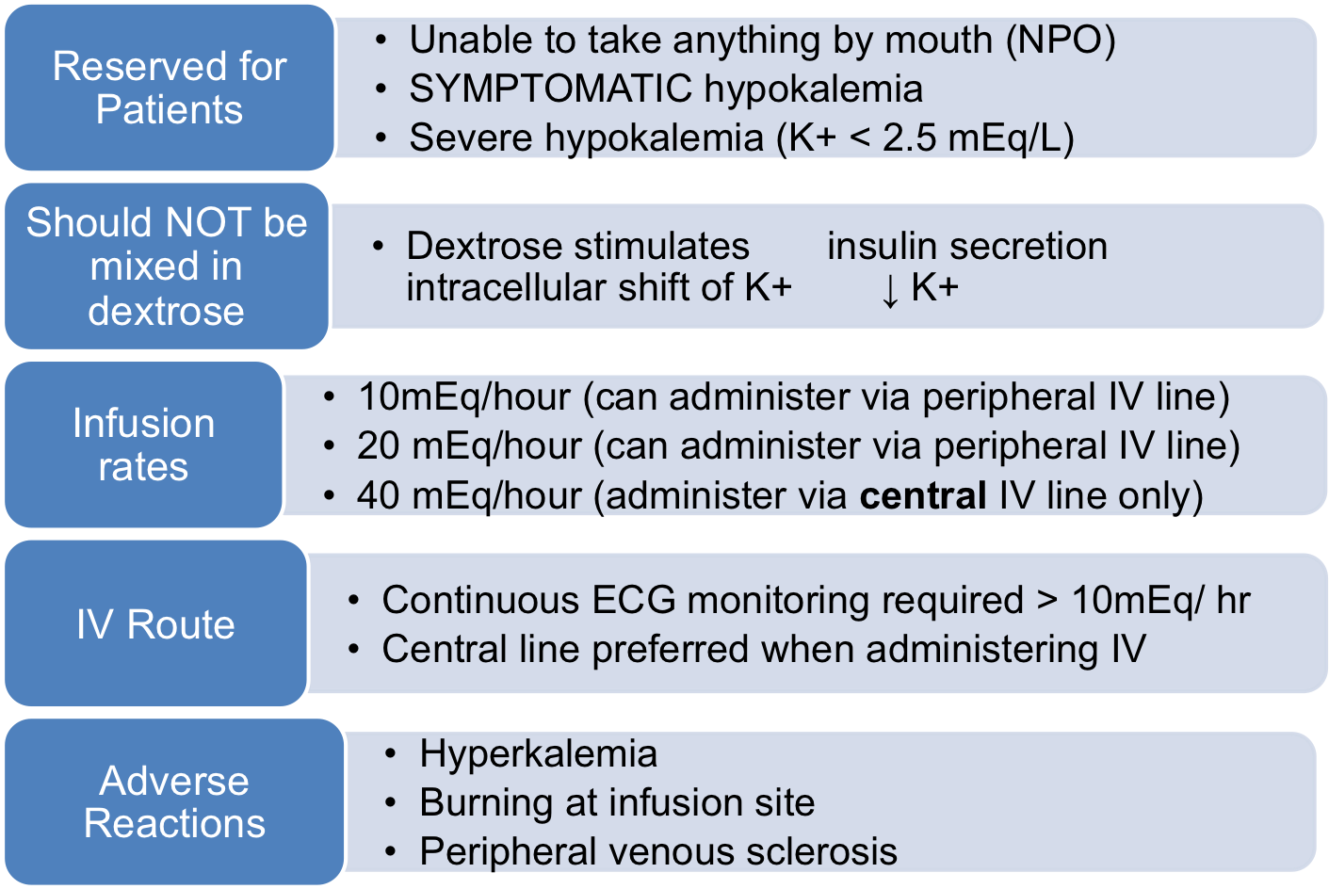
Intravenous (IV) Potassium

Slide 28
Hypomagnesemia Treatment
Example of dosing guidelines for patients with a normal renal function
(Doses in renal insufficiency should be ↓)
Replete over 1- 5 days
Serum magnesium | Recommended dose (1 gram = 8 mEq) (Magnesium sulfate IV rate: 1 gram/ hour)
< 1.2 mg/ dL with life threatening symptoms (i.e. torsades) | Day 1: 2 grams IV push and then 1 mEq/kg IV infusion (1 gram/hour) OR 4- 6 grams IV (32- 48 mEq of magnesium (Mg) Days 2-5: 0.5 mEq/kg (1 gram/hour)
< 1.2 mg/dL without life-threatening symptoms | Day 1: 1 mEq/kg IV infusion or 4- 6 grams IV (32- 48 mEq of Mg) Days 2-5: 0.5 mEq/kg/day
≥ 1.2 mg/dl and < 1.7 mg/dl | Milk of Magnesia (MOM) 5 mL four times daily, magnesium containing antacid 15 mL PO three times daily as tolerated, Magnesium oxide 400 mg PO four times daily OR 1-4 grams IV magnesium (8- 32 mEq of Mg)
Notes:
9:00

Slide 29
Hypomagnesemia Treatment
Goals
  Resolve signs/ symptoms
  Restore normal magnesium levels (1- 5 days)
  Correct other electrolyte abnormalities
  Correct underlying cause
Monitoring
  Monitor every 6- 12 hours until stable for the first 24 hours in symptomatic hospitalized patients
  If level is drawn too soon can be falsely high
  Replacement usually is done over 3- 5 days
  Monitor other electrolyte abnormalities as well (i.e. potassium calcium)

Slide 30
Example of Replacement Protocol
Magnesium IV Replacement Protocol Example (for non-emergent situations in patients with no renal insufficiency)
Fluid for IV admixture: ____0.9% NaCl or _____D5W Labs: Magnesium level 2 hours after end of infusion Magnesium level in AM
Serum Mg Level (mg/dL) | IV Magnesium Dose (rate 1 gram/ hour)
1.5- 1.7 | Magnesium sulfate 2 grams in 100 mL IV over 2 hours
1.2 – 1.4 | Magnesium sulfate 4 grams in 250 mL IV over 4 hours
x < 1.2 | Magnesium sulfate 6 grams in 250 mL IV over 6 hours
Notes:
10:30

Slide 31
Hypermagnesemia (> 2.5 mg/dL)
Normal 1.7–2.4 mg/dL

Slide 32
Causes of Hypermagnesemia
Renal insufficiency
Excessive intake of magnesium containing medications
  i.e. MOM, magnesium citrate
Notes:
11:30

Slide 33
Clinical manifestations of Hypermagnesemia
Mild (2.5- 4 mg/dL)
  Usually asymptomatic
Moderate (4- 12 mg/dL)
  Nausea/ vomiting, loss of reflexes, hypotension, bradycardia, ECG changes
Severe (> 12 mg/dL)
  Paralysis, coma, respiratory depression, AV block cardiac arrest, death

Slide 34
Treatment of Hypermagnesemia
Correct the underlying cause
Calcium chloride 0.5- 1.0 grams IV
Cardiac pacing
Loop diuretics (i.e. furosemide 40 mg IV)
Hemodialysis

Slide 35
Phosphorus Homeostasis

Slide 36
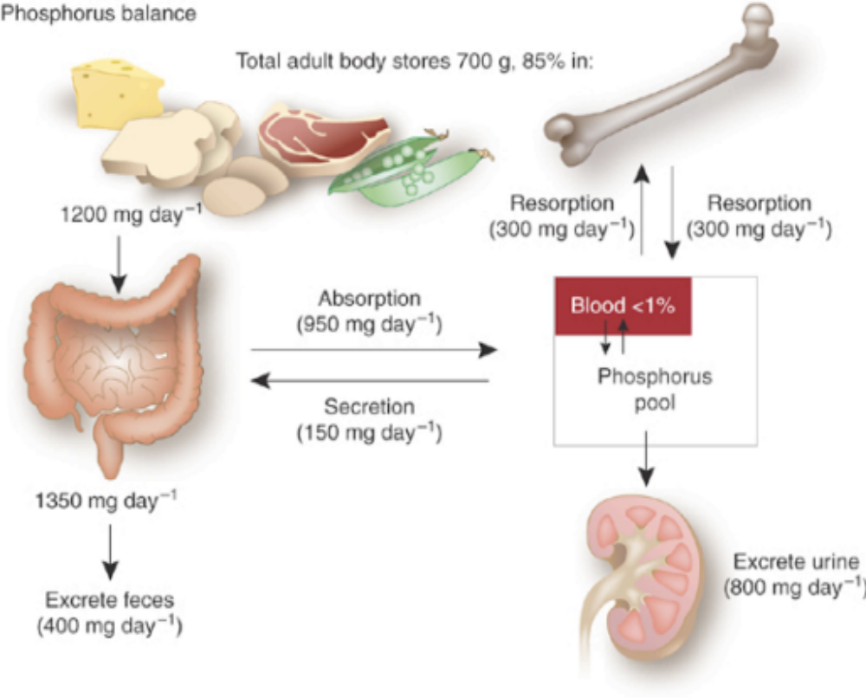
Phosphorus Homeostasis
Normal range is 2.5- 4.5 mg/dl
Required for the production of ATP (regulates muscle contraction, neurologic function, and electrolyte transport)
Notes:
13:30

Slide 37
Hypophosphatemia (< 2.5 mg/dL)
Normal: 2.5-4.5 mg/dL

Slide 38
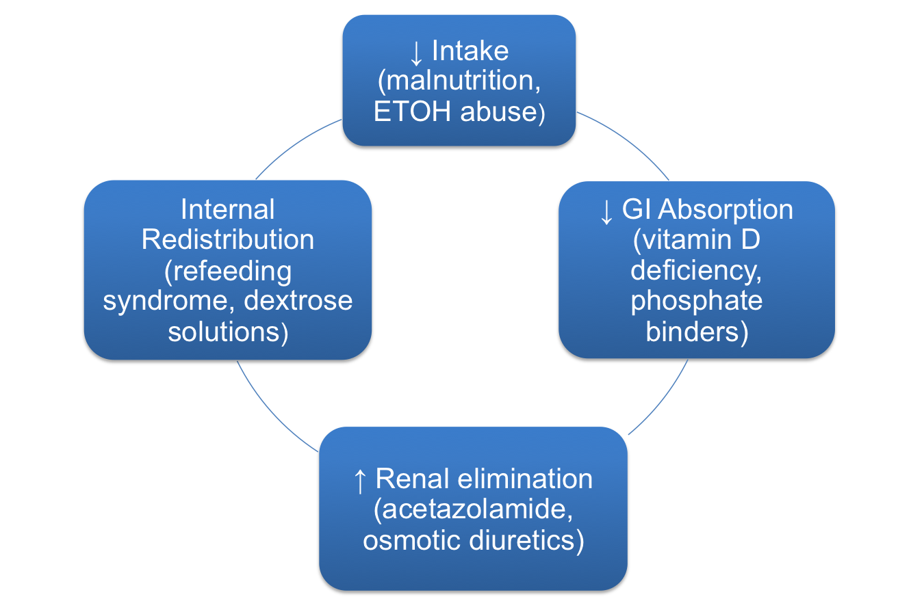
Causes of Hypophosphatemia
Notes:
14:00

Slide 39
Hypophosphatemia Manifestations
1.5- 2.5 mg/dl usually asymptomatic
Neurologic: irritability, weakness, coma, seizures
Muscular: myalgias, rhabdomyolysis, weakness
Hematologic: hemolysis, WBC, and platelet dysfunction
Bone (chronic): osteopenia, osteomalacia, bone pain
Pulmonary: respiratory failure and impaired diaphragm function
Cardiac: arrhythmias, cardiomyopathy

Slide 40
Treatment of Hypophosphatemia
Normal: 2.5-4.5 mg/dL
Mild (asymptomatic) administer PO therapy
Moderate (< 1.5 mg/dL) to severe (< 1mg/dL), or symptomatic administer IV
  IV therapy associated with:
    Soft tissue deposition of Ca/Phos product
    Hyperphosphatemia
    Hypocalcemia
    Hypomagnesemia
    Hypernatremia and hyperkalemia (caused by phosphate salt)

Slide 41
Treatment of Hypophosphatemia
Product | Phosphate content
Oral therapy
K-phos Neutral (13 mEq Na/ tablet; 1.1 mEq K+/ tablet) | 250 mg/ tablet
Phos-NaK (6.9 mEq Na and 7.1 mEq K+/ packet) | 250 mg/ packet
Neutra-phos (7 mEq Na and K+/packet) Neutra-phos K (14 mEq K+/ packet) *Taken off the market | 250 mg/ packet
Intravenous therapy
Sodium phosphate (4 mEq Na/ mL) | 3 mmol/ mL
Potassium phosphate (4.4 mEq K+/ mL) *Remember we are limited to how fast we can infuse K+ (10 mEq/hour vs. 40 mEq/hour) | 3 mmol/ mL
*Phosphate replacement will always be in combination with another electrolyte

Slide 42
Case #3
You are working at TUH’s inpatient pharmacy when a physician calls and asks your recommendation of how to treat their internal medicine patient’s hypophosphatemia. What would be the most appropriate agent to give?
Na= 138 mEq/L K= 3.0 mEq/L Cl= 110 mEq/L Phos= 1.0 mg/dL
BUN=21 Scr=1.2

Slide 43
Treatment of hypophosphatemia
Monitoring
  Repeat phosphorus level in 6 hours after repletion
  Caution in patients with renal failure
  Inappropriately high doses can cause:
    Hyperphosphatemia
    Hypocalcemia
    Soft tissue deposition from Ca++ and phosphate product
Example of Dosage Guidelines for patients with normal renal function
Serum phosphorus (mg/dL) | Dosage (mmol/kg)
2.1- 2.4 | 0.16
1.5- 2.0 | 0.32
< 1.5 | 0.64
Dickerson. Hospital Pharmacy 2001; 36: 1201
Notes:
21:40

Slide 44
Case #4
JC is a 45 y/o female, with a history of alcoholic cirrhosis and diabetes. She recently quit drinking (history of drinking ½ liter of Jameson whiskey per day). Her family called 911 because she had a seizure. JC was admitted to TUH and was intubated for airway protection and brought to the ICU 10 days ago. Enteral nutrition was started 3 days ago.
Na= 138 mEq/L K= 3.2 mEq/L Cl= 103 BUN= 21 Scr= 1.2
Mg= 1.7 mg/dl Phos= 0.9 mg/dL
Weight= 48 kg
What would be an appropriate treatment plan for her?

Slide 45
Calcium Homeostasis

Slide 46
Physiologic role of Calcium
Preserve function of cell membrane
Neuromuscular activity
Blood coagulation cascade/ platelet adhesion
Bone metabolism
Muscle contraction
Cardiac function
Notes:
23:00

Slide 47
Distribution of Calcium
Normal range: 8.5- 10.5 mg/dL
Distributed 99.5% in bone and 0.5% in ECF
Protein binding to albumin: 46%
Only the “free” unbound or ionized calcium is physiologically active
  Unbound/ionized calcium =4.5- 5.5 mg/dl
Regulated by parathyroid hormone (PTH), phosphorus, vitamin D, and calcitonin

Slide 48
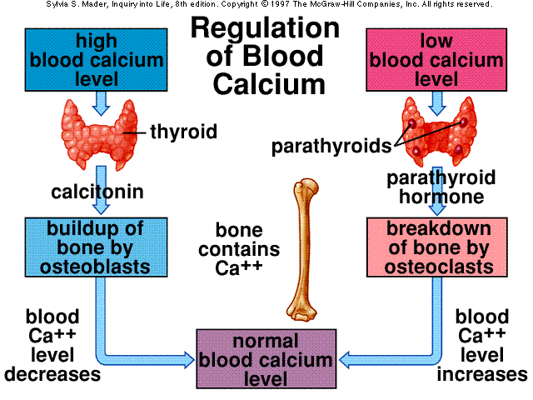
Notes:
24:30

Slide 49
Factors which affect Calcium
↓ Albumin (albumin < 4 gm/dl)
  Calcium level may appear falsely low
  Corrected calcium (mg/dl)
pH
  Acidosis: ↑ unbound calcium available
  Alkalosis: ↓ unbound calcium available
  [(4 gm/dl – serum albumin) x 0.8] + serum calcium
Notes:
equation posted

Slide 50
Hypocalcemia (< 8.5 mg/dl)
Normal range: 8.5- 10.5 mg/dL

Slide 51
Causes of Hypocalcemia
*Post-operative hypoparathyroidism
Renal insufficiency
Vitamin D deficiency
Magnesium deficiency
Administration of blood preserved by citrate
Drugs
  Loop diuretics
  Calcitonin
  Bisphosphonates
  Phenobarbital/phenytoin

Slide 52
Clinical Manifestations
Neuromuscular
  Paresthesias, tetany, muscle spasms/cramps
    Tetany: parathesia around the mouth and in the extremities; very stiff muscle spasms and cramps
    Muscle spasms: + Chvostek’s sign and + Trousseau’s sign
Cardiovascular
  QT prolongation, decreased myocardial contractility, bradycardia
CNS
  Depression, anxiety, memory loss, hallucinations, seizures
Dermatologic
  Hair loss and brittle nails (occurs more with chronic hypocalcemia)

Slide 53
Treatment of Hypocalcemia
Treat underlying cause
 | Asymptomatic | Severe or Symptomatic
Treatment | PO Elemental calcium 2- 4 grams/day Vitamin D supplementation Vitamin D Calcitriol Paracalcitriol Doxercalciferol Adverse reactions: hypercalcemia, nephrolithiasis, constipation | IV 200- 300 mg elemental calcium 1 gram calcium chloride 270 mg elemental calcium 1 gram calcium gluconate 90 mg of elemental calcium Do not infuse calcium at a rate > 60 mg elemental calcium/ min Duration of bolus ~ 1-2 hours therefore follow with a continuous infusion until calcium normalizes Do not administer with bicarbonate and phosphorus- PRECIPITATION Monitor every 4- 6 hours
Notes:
28:30

Slide 54
Treatment of Hypocalcemia
Salt | Elemental calcium | Dosage formulation | Comments
Calcium chloride *Use is restricted to severe situations | 13.6 mEq/1 gm | Intravenous 10%, 1.36 mEq/ml | *Administered through central line to avoid extravasation & tissue necrosis
Calcium gluconate | 4.5 mEq/ 1 gm | Intravenous 10%, 0.45 mEq/ml & oral | Preferred IV form, can be given peripherally
Calcium carbonate | 20 mEq/ 1 gm | oral | Poorly absorbed, need vitamin D and acidic environment
Calcium citrate | 10.5mEq/ 1 gm | oral | Citrate can cause acidosis, increases absorption of Aluminum

Slide 55
Treatment of Hypocalcemia
Treat underlying cause
If hyperphosphatemia is present calcium supplementation should be delayed until serum phosphate < 6 mg/dl to avoid precipitation
Calcium and phosphorus product < 55
Notes:
32:00

Slide 56
Hypercalcemia (> 10.5 mg/dl)
Normal range: 8.5- 10.5 mg/dL

Slide 57
Causes of Hypercalcemia
Cancer*
Primary hyperparathyroidism
Drugs
  Lithium (increase bone resorption)
  Thiazides (increase reabsorption of calcium from the kidneys)
Mechanisms
  Increased bone resorption
  Increased GI absorption
  Decreased elimination by the kidney
Notes:
32:00

Slide 58
Clinical manifestations of hypercalcemia
< 13 mg/dl: usually asymptomatic
≥ 13 mg/dl
  Acute: anorexia, N/V, constipation, polyuria
  Chronic: metastatic calcification, nephrolithiasis, calcium deposits in atherosclerotic lesions
≥15 mg/dl: hypercalcemic crisis
  Renal insufficiency, obtundation and can lead to renal failure, coma, ventricular arrhythmias and death

Slide 59
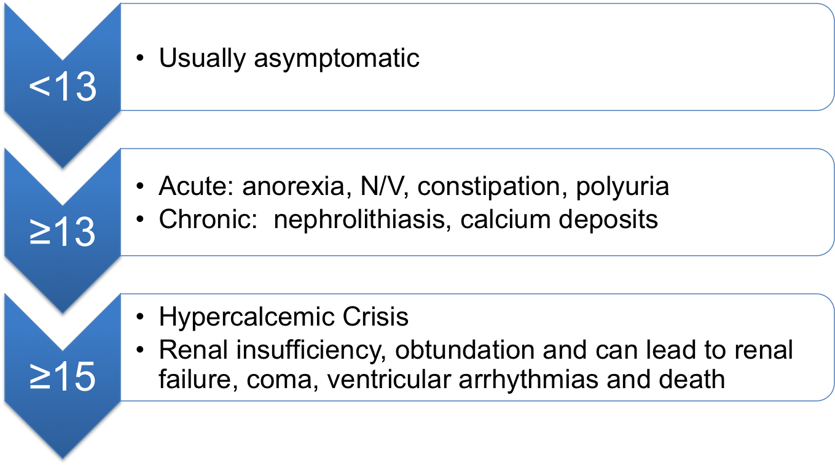
Clinical manifestations of Hypocalcemia

Slide 60
Drug | MOA | Dose | Onset | Adverse effects | Warnings/ Precautions/ Comments
IV Fluids (Saline) | ↑ urine Ca excretion | 200-300 ml/hour | 24-48 hours | Fluid overload | Severe renal failure, CHF
Diuretics (Loop) Furosemide | ↑ urine Ca excretion | 40-80 mg IV |  | Worsening hyperCa++ | Dehydrated patients
Calcitonin | Inhibits bone resorption, calciuresis | SC/IM 4units/kg Q12 hour IV: 10 units/hour | 1-2 hours | Flushing, n/v, allergic rxn, tachyphylaxis | Allergy (most formulations are made from salmon)
Gluco-corticoids | ↓GI absorb, | 40- 60mg prednisone equivalent | ~5 days | Osteoporosis, DM, infection | Infection
Gallium nitrate | Inhibits bone resorption | 200 mg/m² x 5 days | 12 hours | Nephrotoxic, N/V/D *high toxicity | Renal insufficiency
Notes:
33:50

Slide 61
Treatment of Hypercalcemia
Bisphosphonates
Caution in patients with CrCl < 30 ml/min
Used in chronic patients with hypercalcemia
Takes a while to work 2 days (Nadir 7 days)
Drug | MOA | Dose | Onset | Comments
Pamidronate | Block bone resorption via action on osteoblast & osteoclast precursors | 30-90 mg IV over 2-24 hours | 2 days (nadir 7 days)
Etidronate |  | 7.5 mg/kg IV over 2 hours |  | Not as effective as other agents
Zoledronic acid (Zometa®) |  | 4-8 mg IV over 15 min |  | Most potent, longer duration of action
Ibandronate (Boniva®) |  | 2- 6mg IV over 2 hours |  | Relapse was longer compared to pamidronate

Slide 62
Treatment for Acute Onset of Hypercalcemia
Asymptomatic > 12 mg/dL
Asymptomatic
≤12 mg/dL
Symptomatic
Non-life threatening
Symptomatic Life- threatening +
functioning kidneys
Symptomatic
Life-threatening +
severe renal Insufficiency
Observe and correct reversible causes
Saline rehydration
Loop diuretic
Calcitonin
Glucocorticoid
IV bisphosphonate
Mithamycin
Saline rehydration
Loop diuretic
HD (if nonfunctioning kidneys)
Calcitonin
Glucocorticoid
Gallium nitrate
Hemodialysis (HD)
Calcitonin
Glucocorticoid
Signs and Symptoms:
Non- life threatening: muscle weakness, fatigue, cognitive dysfunction, abdominal pain
Life- threatening: EKG changes, tetany, or pancreatitis
DiPiro’s 8th edition

Slide 63
Treatment Hypercalcemia
Remove offending causes
  Surgery in PTH disorders
  Reduction of tumor load
Hypercalcemic crisis requires dialysis
Depends on acuity of its development
  Hypercalcemic crisis and acute symptomatic (severe) hypercalcemia (acute life-threatening)
    Volume expansion +/- loop diuretics
    Calcitonin +/- glucocorticoids
    Hemodialysis (HD)
  Chronic asymptomatic
    Calcitonin 50- 100 IU SC daily or 3 x week
    Cinacalcet 30 mg PO twice daily and titrate up to desired calcium in parathyroid carcinoma
    Kidney stone dissolution
    Low calcium diet

Slide 64
Monitoring of Hypercalcemia
Calcium
Albumin
Volume status
    Effects only last for short period of time
    Monitor improvement of mental status
Relief of symptoms
    May need to give longer lasting agents
    Bisphosphonates
      Should see complete response by day 7 and response may last up to 3 weeks (nadir= 7 days)
    May need maintenance therapy

Slide 65
Case #5
SA is a 45 y/o female presenting to her oncologist’s office with c/o confusion, lethargy, nausea, and constipation. She states that she has not felt like herself over the past 2 weeks. Her husband states that she has been acting “goofy” at times and is unable to recognize family members. Her skin appears dry on physical exam
PMH: Breast cancer, hypertension, tonsillectomy
Medications: tamoxifen, HCTZ, calcium citrate, docusate prn
Labs: Na= 146 K= 3.2 Scr= 1.5 Albumin= 2 gm/dl Ca= 12.5 mg/dl
EKG: normal

Slide 66
Case #5 continued
What is SA’s corrected calcium?
What are the therapeutic options for the acute treatment of the hypercalcemia?
How would you monitor therapy in SA?

Slide 67
Questions?

